Slide 1
A Parallel Algorithm for Computing Fourier
Transforms on the Star Graph
Paraskevi Fragopoulou and Selim G. Akl
IEEE TRANSACTIONS ON PARALLEL AND DISTRIBUTED SYSTEMS, VOL. 5, 1994
Presenter: Chiao-Wei Chiu
Date: Mar. 26, 2008

Slide 2
Abstract
The n-star graph, denoted by S_{n}, is one of the graph networks that have been recently proposed as attractive alternatives to the n-cube topology for interconnecting processors in parallel computers. In this paper, we present a parallel algorithm for the computation of the Fourier transform on the star graph. The algorithm requires O(n²) multiply-add steps for an input sequence of n! elements, and is hence cost-optimal with respect to the sequential algorithm on which it is based. To the best of our knowledge, this is the first algorithm, and the only one to date, for the computation of the Fourier transform on the star graph.

Slide 3
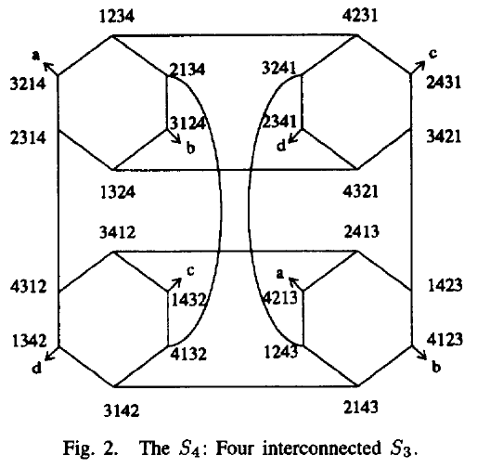
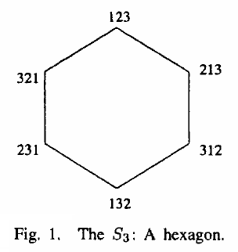
The star graph

Slide 4
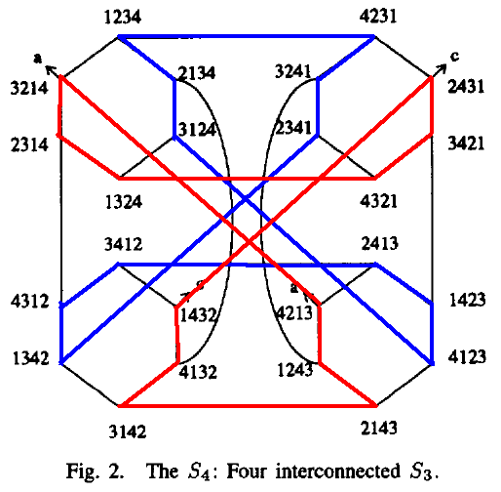
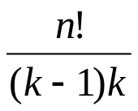
A decomposition scheme for the star graph
Recently, a new decomposition
scheme was proposed, which
partitions S_{k} into (k - 2)! disjoint
cycles of length (k - 1)k each.
S_{n} can be decomposed into
n!/k! substars S_{k} (k <n)
As a consequence,
S_{n} can be decomposed
into disjoint cycles
of length (k - 1)k each.

Slide 5
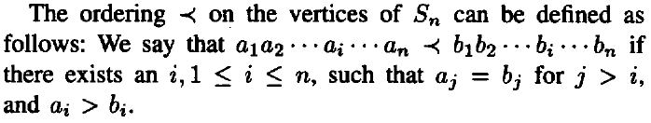
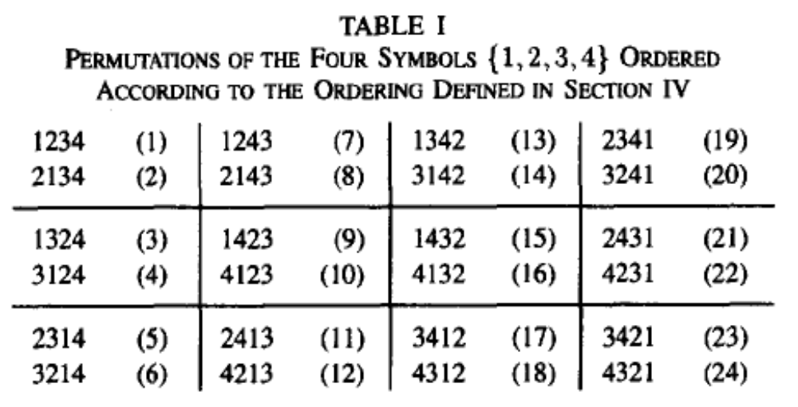
Ordering of the vertices
index of node a₁a₂...a_{i}...a_{n} is given by ∏(a₁a₂...a_{i}...a_{n}).

Slide 6
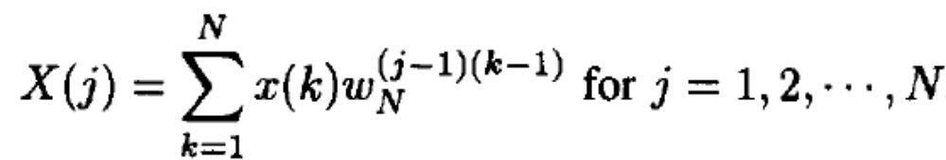

The Cooley-Tukey fast Fourier transform
Given a sequence of numbers {x(1),x(2),...,x(N)}, its Fourier transform (FT) is the sequence resulting from evaluating the following expression:
Suppose that N = r₁ x r₂ ...

Slide 7
The divide and conquer method
If we view the N elements as being arranged into an r₁ x r₂ x . . . x r_{m}, m-dimensional grid, then, elements that are adjacent over dimension (m - i + 1) of the grid participate into FT computations. This algorithm requires a total of N(r₁ + r₂ + . . . + r_{m}) operations.
When N is a power of 2, then r_{i} = 2 for every i, and we get the classical and more well-known radix-2 FFT algorithm requiring N log N operations
Another example of particular interest in this paper is when N = 1 x 2 x ... x n, in which case the number of operations required is O(Nn²).

Slide 8
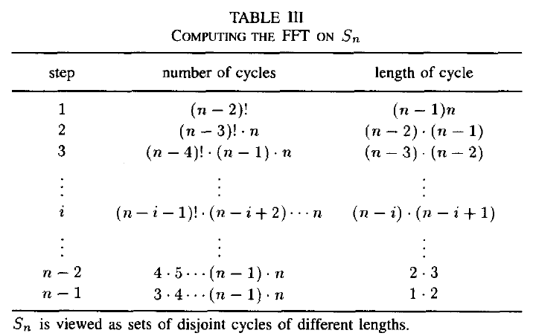
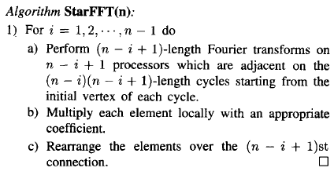
The Fourier transform on the star graph (StarFFT)
N = n! = 1 x 2 x ... x n = r₂ x r₃ x ... x r_{n-1} x r_{n}
Each vertex receives an element x(i)

Slide 9
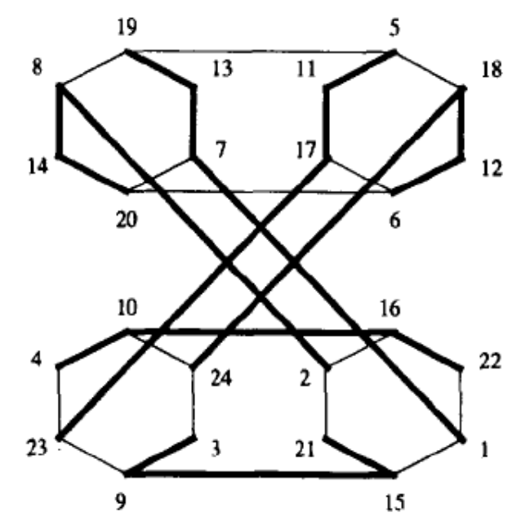
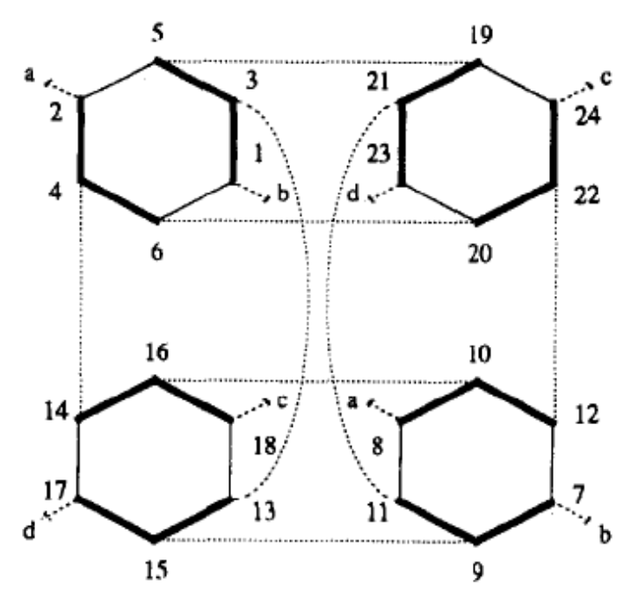
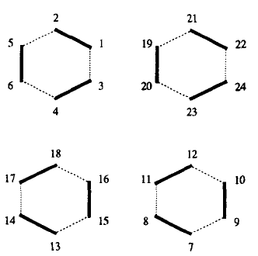
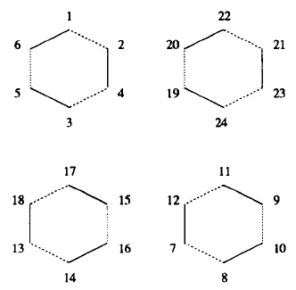

Slide 10
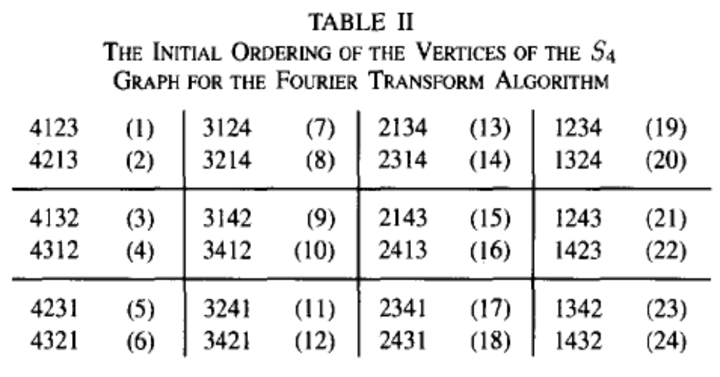
Rearrangements in the algorithm
If an element is initially stored in the processor indexed by the permutation a₁a₂...a_{i}...a_{n}, then after the n-1 rearrangements, it is stored in processor indexed by the permutation a_{n}a₁...a_{i}...a_{n-1}.
In other words, the processor indexed by the permutation a_{n}a₁...a_{i}...a_{n-1} must have the element whose index is ∏(a₁a₂...a_{i}...a_{n}).

Slide 11
Making the Algorithm Adaptive
If the length l ≠ n!
Padding with zeros to kn!
Each vertex receives k elements
Compute locally a Fourier transform of length k.
Run StarFFT

Slide 12
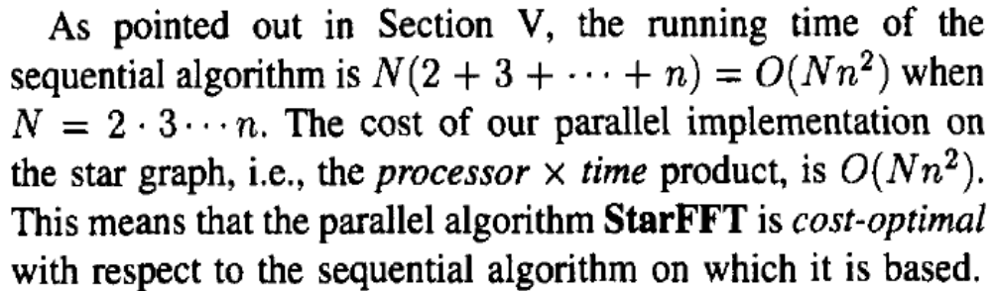
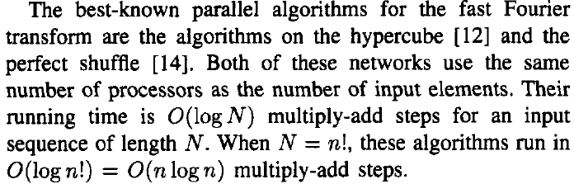
Conclusion

